Slide 1

Referral Page Update Plan
Jason
2021.04.26

Slide 2
Objective
Enhance Speed of Incentive Calculation and its accuracy by updating Referral Page

Slide 3
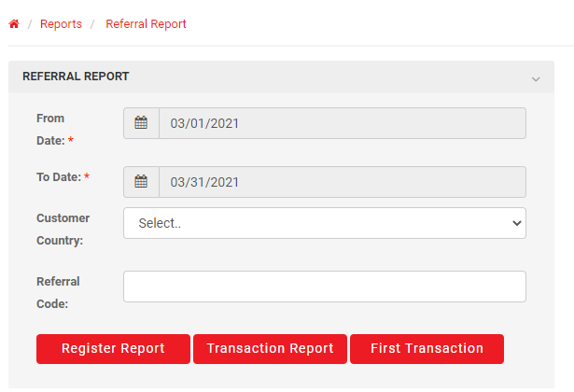
Current
Functions
Filters
Date Setting (Duration)
By Country
By Referral Code
Category
Register Report
Transaction Report
First Transaction

Slide 4
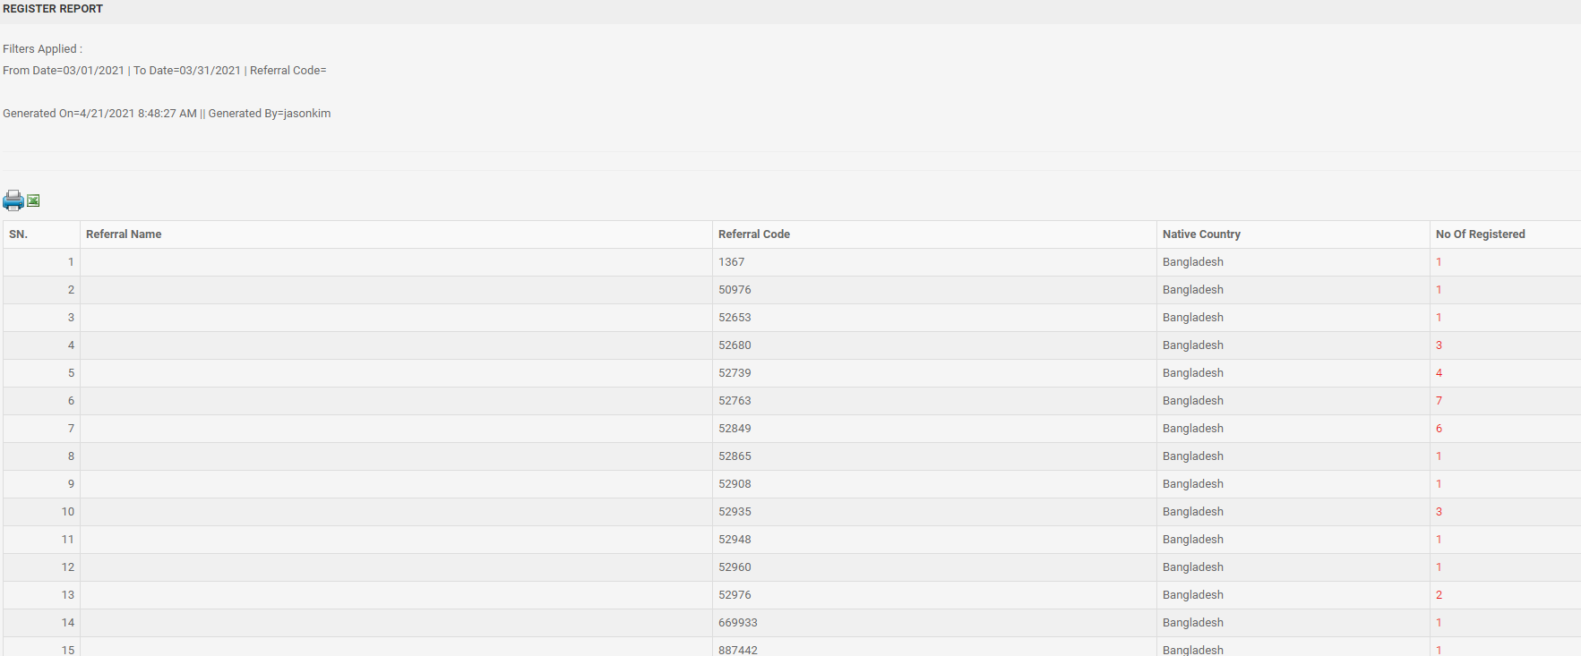
Current
Register Report
Number of Registration by Referral Code and Native Country of Sender
Click the number of registration and see the details of sender

Slide 5
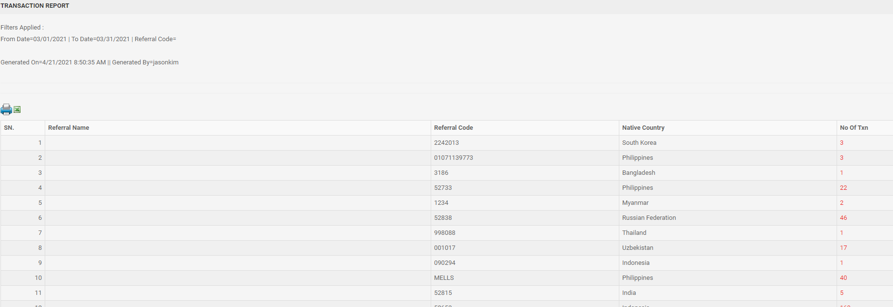
Current
Transaction Report
Number of Transaction by Referral Code and Native Country of Sender
Click the number of registration and see the details of sender
Do not know if the result is 1st transaction only or including all
Do not know total transaction number of specific referral code because it is divided into nationalities

Slide 6
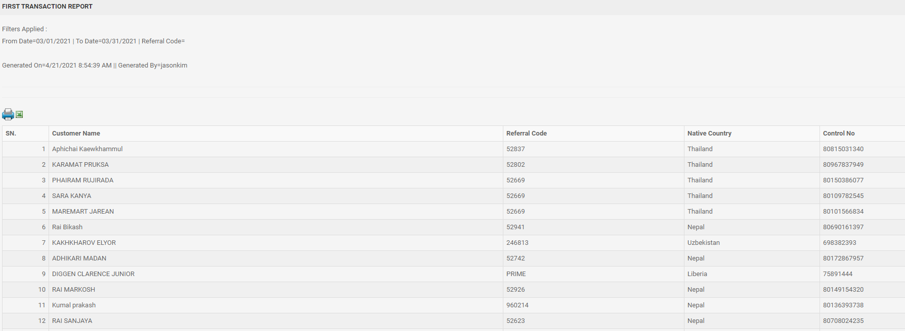
Current
Transaction Report
Number of Transaction by Referral Code and Native Country of Sender
Do not know total transaction number of specific referral code because it is divided into nationalities

Slide 7
Current
Types of Registration related Incentive and payments
Staff Registration
Staff or customer put Staff’s Core User Code (ex.52776) in referral code section while registering to GME, and then made 1st transaction then pay 1,200 KRW per case to Referral code holder (Staff)
Staff who approved a customer and customer made 1st transaction then pay 800 KRW per case
1 and 2 can happen together in a single 1st transaction

Slide 8
Current
Types of Registration related Incentive and payments
B. PowerCall Payment
If a customer registered through Powercall App they will have referral code ‘POWERCALL’
If a customer make transactions GME pays 1,000 KRW per case except:
First Transaction
Cancelled Transaction

Slide 9
Current
Types of Registration related Incentive and payments
C. Introducer Payment
Introducer who use their referral for registering a customer
If customer make transaction (either 1st transaction or following transaction) GME will pay depends on the terms and condition of introducer program

Slide 10
Suggestion
Add Incentive Button
Maintain current buttons and filters
Add Incentive Button
When click show incentive calculation table
Incentive Report

Slide 11
Suggestion
Incentive Table
Consist of followings:
SN.
Referral Code (User Code for Staffs)
No of 1st transaction
No of following transaction
No of Approval

Slide 12
Suggestion
Incentive Table
SN. – Numbering for each referral Code
Referral Code (User Code for Staffs) – Either Referral code or User Code ‘ex 52776’
No of 1st transaction – Transaction that made 1st time after registration in the period
No of following transaction – (Total transaction in the period – 1st transaction in the period)
No of Approval – Number of approval (‘Marked as approvedby’ – sync with user code)

